Slide 1

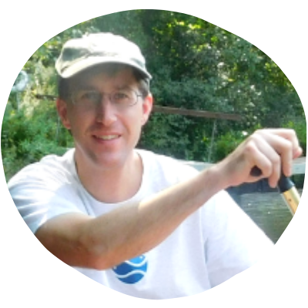
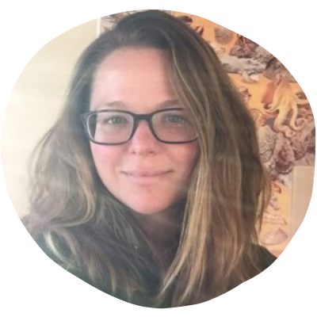


Welcome! Thank you for joining us for
Remembering River Herring
Ryan O’Donnell
Programs Coordinator
Kaitlyn Shaw
Science & Restoration
Programs Manager
Rachel Schneider
Outreach Manager

Slide 2
Welcome! Thank you for joining us for
Remembering River Herring
A few things before we start:
During the presentation, attendees will be on mute.
If you have a question, please type it into the
chat box, or wait until the end of the presentation.
Our presenters will answer questions at the end.
Thank you and enjoy the presentation!
Rachel Schneider
Outreach Manager

Slide 3
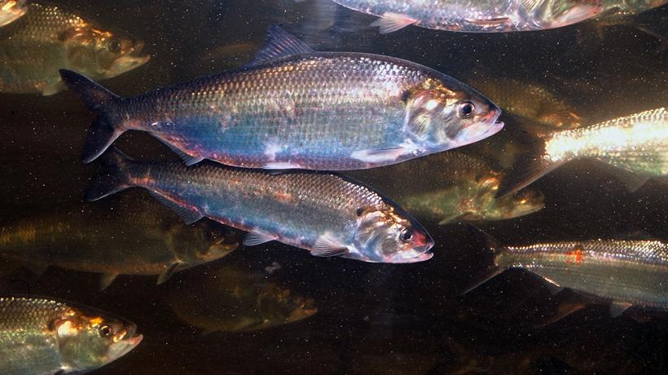
Where did we go?
And how can you bring us back?
Photo from mass.gov
Remembering River Herring

Slide 4
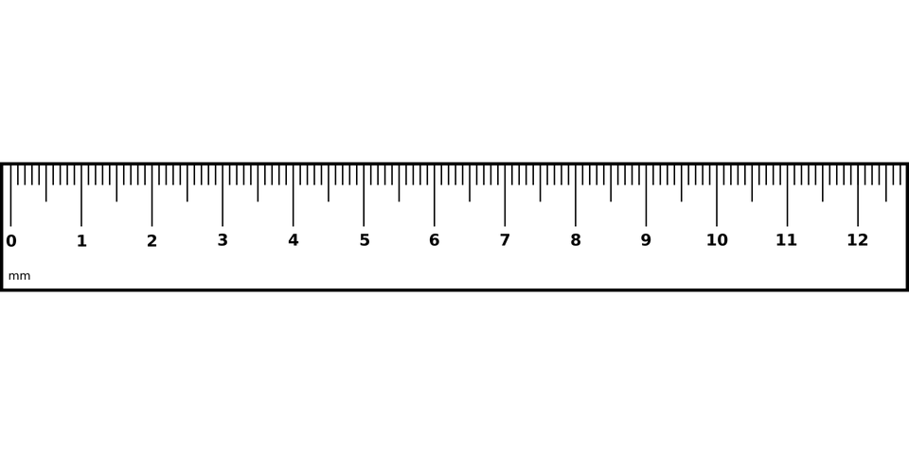
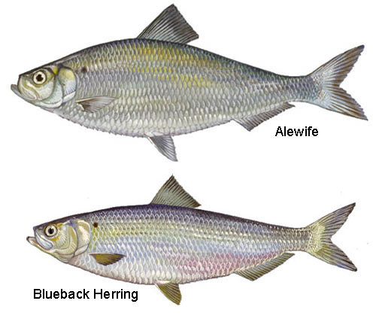
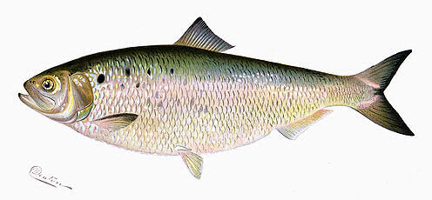
Who are
River Herring?
Herring is a general name that
covers a variety of species, including:
Alewife
American Shad
Blueback Herring
up to 15”
American Shad
up to 24“
We’re Diadromous Fishes!
up to 11”

Slide 5
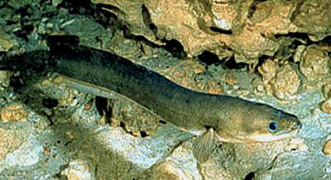
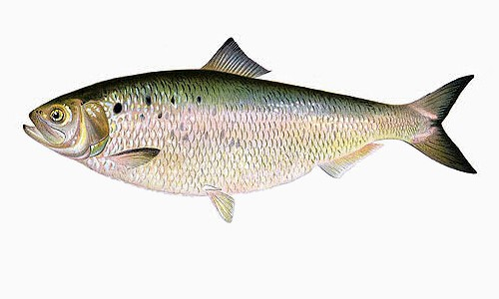
Diadromous Species = They spend part of their lives in saltwater and the rest in freshwater.
Some diadromous species are Catadromous.
This means they spawn in saltwater, but live their adult lives in freshwater.
Like the American eel
Sea-run brook trout
Herring are Anadromous, meaning they spawn in freshwater then spend their adult lives at sea.
http://www.chesapeakebay.net/
Notes:
Just to be clear on definition.

Slide 6
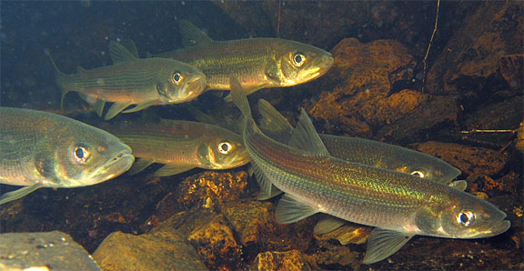
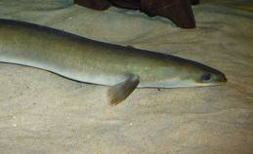
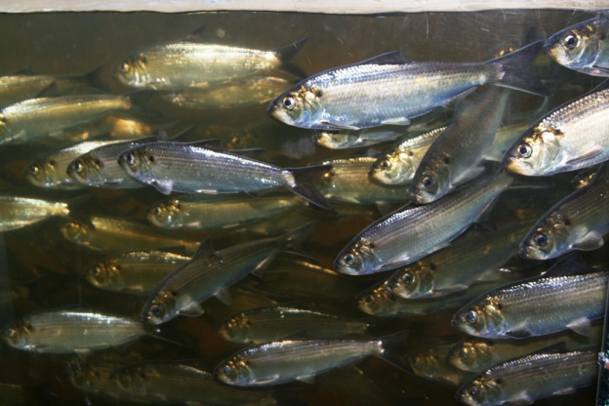
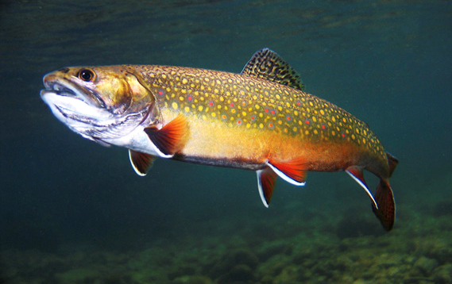
That makes Herring Migratory Fish.
Other species of migratory fish native to our region include:
http://pblabs.biology.dal.ca/
Rainbow Smelt
American Eel
Sea Lamprey
Atlantic Salmon*
Atlantic and Shortnose Sturgeon*
http://www.thevlm.org/eel.aspx
http://mainerivers.org/river-life/alewife/
http://onemoregeneration.org/
This Shad finds that sad!
*Some migratory species disappeared
from our region back in the 1800’s
http://www.chesapeakebay.net/

Slide 7
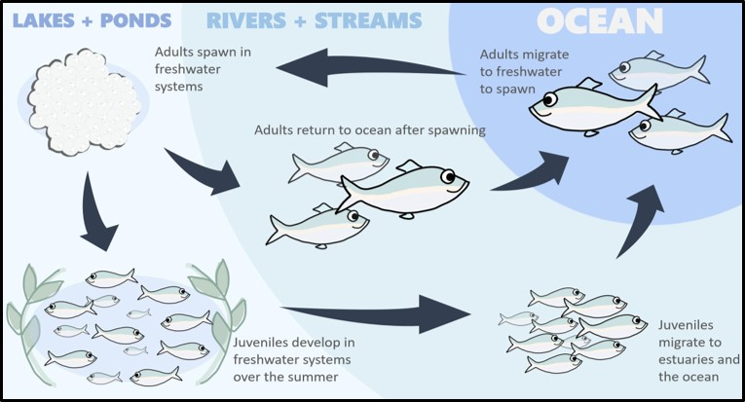
The Herring Life Cycle looks like this:
image from www.zooniverse.org
Lots going on! Let’s look at the steps….

Slide 8
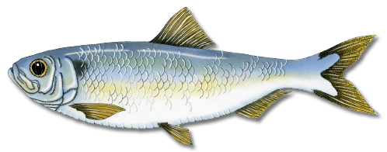
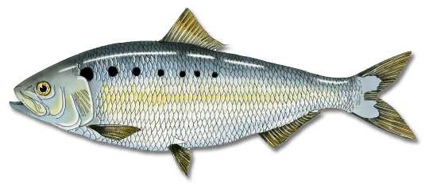
Adult Herring spend their lives in the ocean, but then comes their time to spawn!
We don’t know how they do it, but Herring navigate back to their natal (birth) waters.
I’m heading home!
Once home, they spawn and return to the sea.

Slide 9
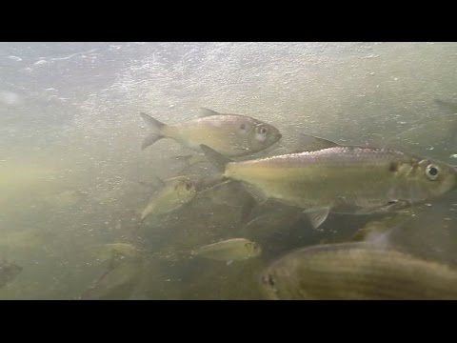
Spawning means
Female and male herring each release clouds of their reproductive material for mass fertilization!
Alewife Herring spawn in lakes and ponds.
American Shad and Blueback Herring
spawn in rivers and streams.

Slide 10
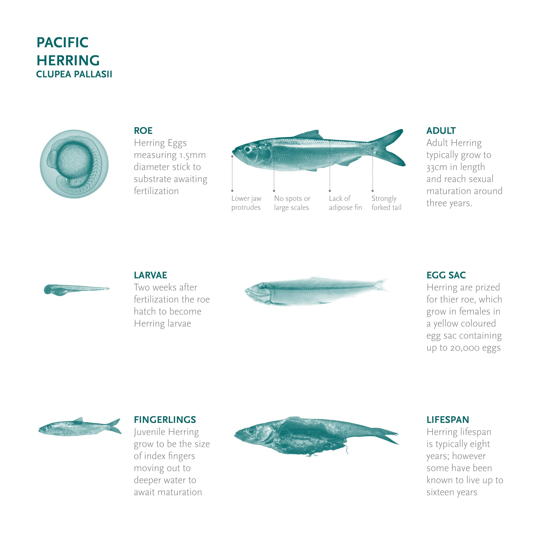
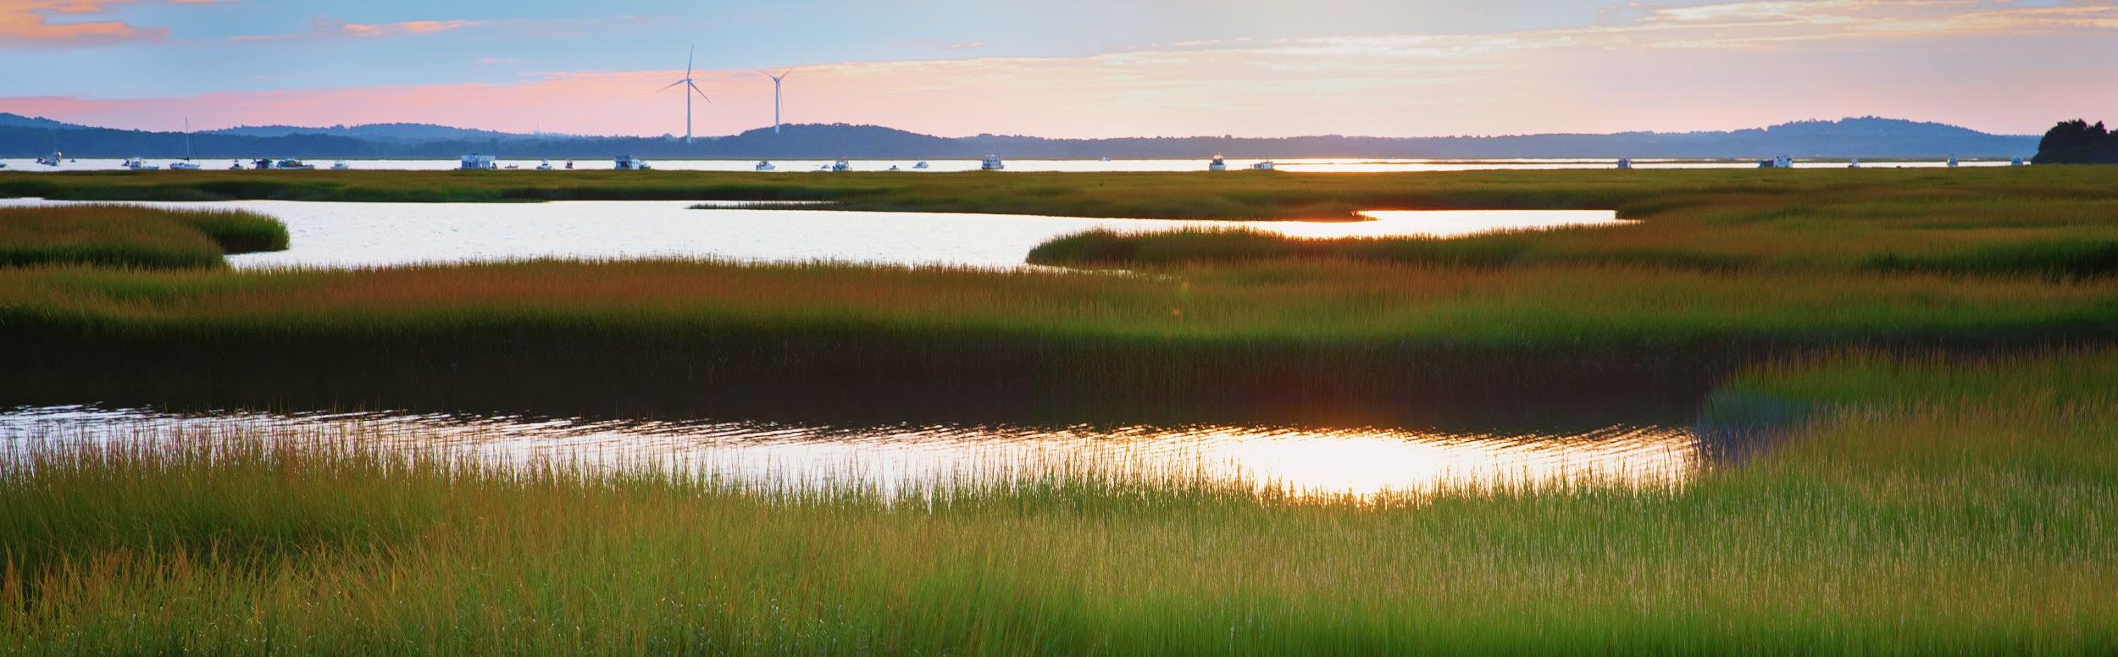
Now for the final steps!
The Herring grow from...
FINGERLING
LARVAE
EGG
...and migrate to the ocean by way of freshwater tidal zones then estuaries where they make the transition from fresh to saltwater.

Slide 11
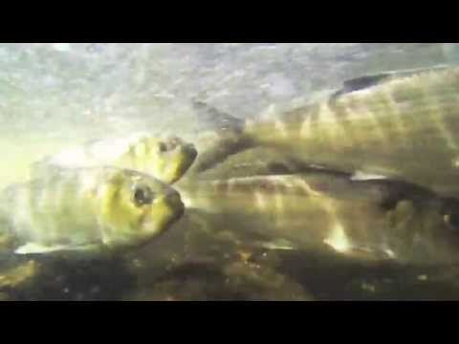
At least that’s what is MEANT to happen, but for Ipswich River Herring, something stands in the way.
Notes:
End of Ryan’s section

Slide 12
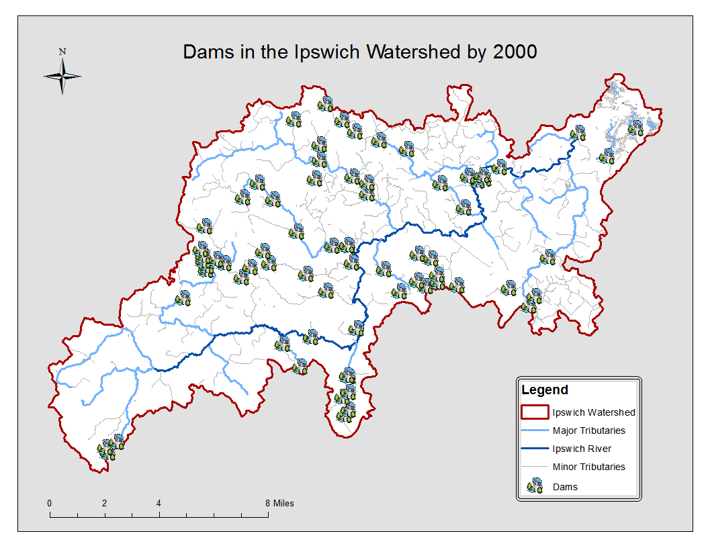
Several somethings in fact: dams and outdated culverts.
Notes:
Today there are approximately 74 dams in the watershed. It is very likely that many of these dams were built much earlier in the region’s history than shown on this animation

Slide 13
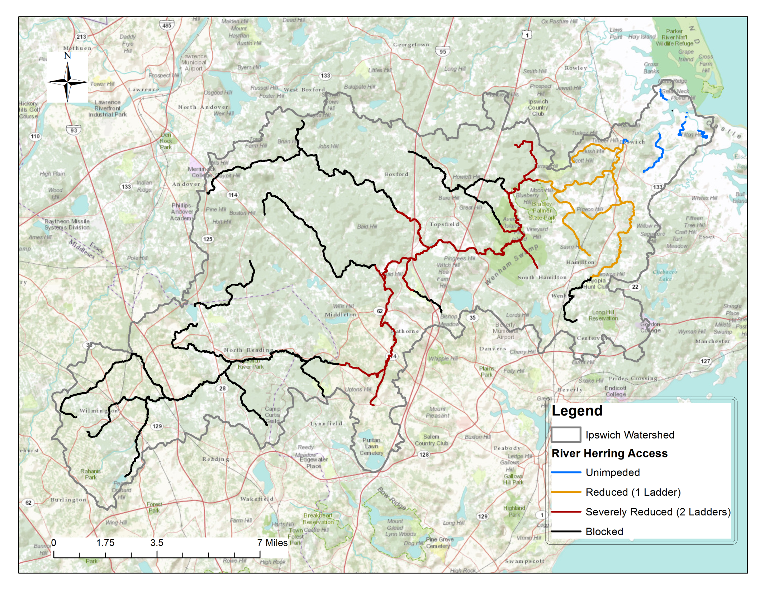

As this map shows, nearly all of the waterways in the Ipswich River watershed have severely reduced access for migratory fish or are completely BLOCKED.

Slide 14
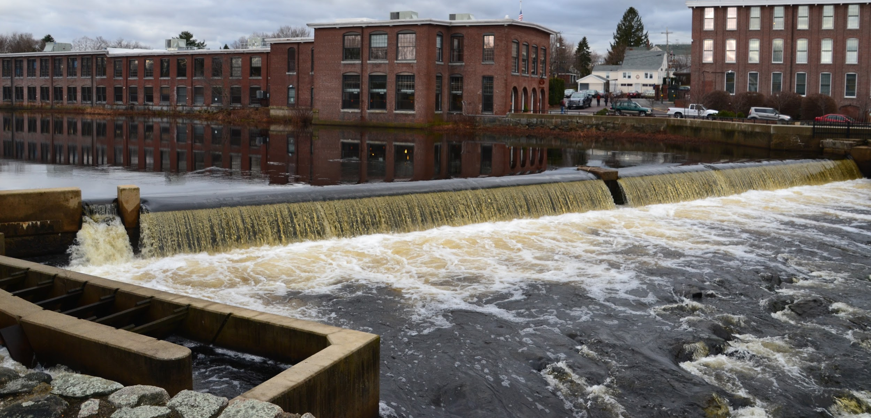
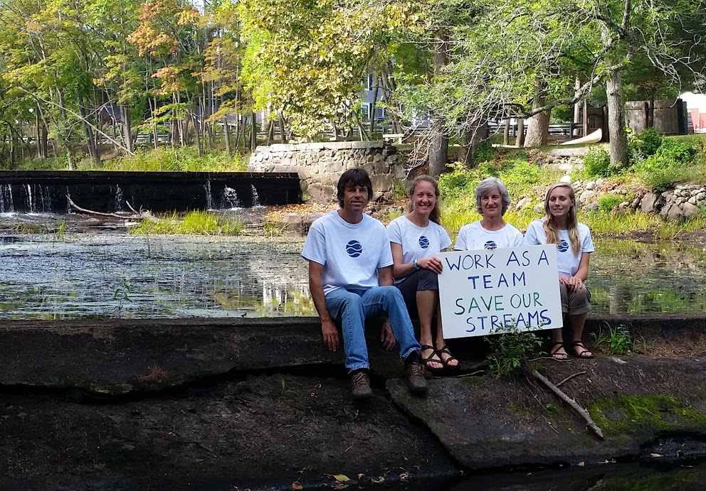
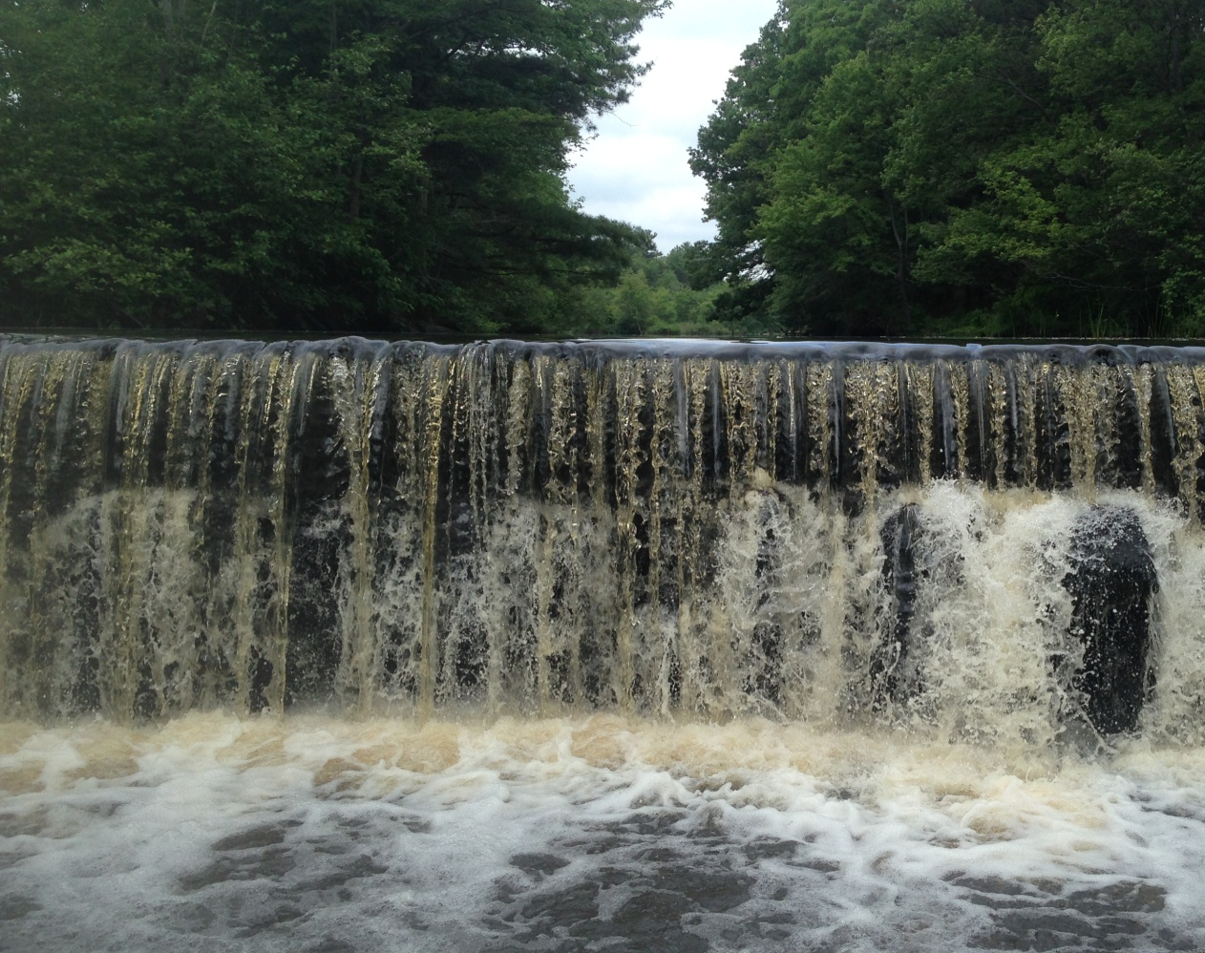
There are three dams on the main stem of the
Ipswich River (sometimes called run-of-river dams).
Ipswich Mills Dam
Willowdale Dam
South Middleton Dam

Slide 15
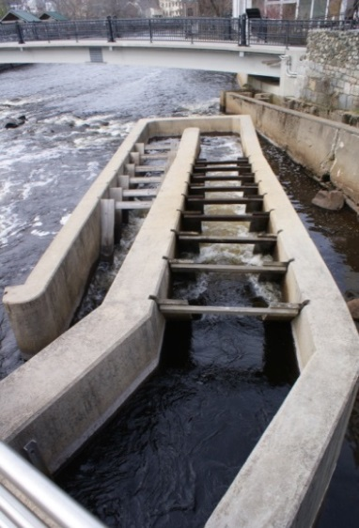
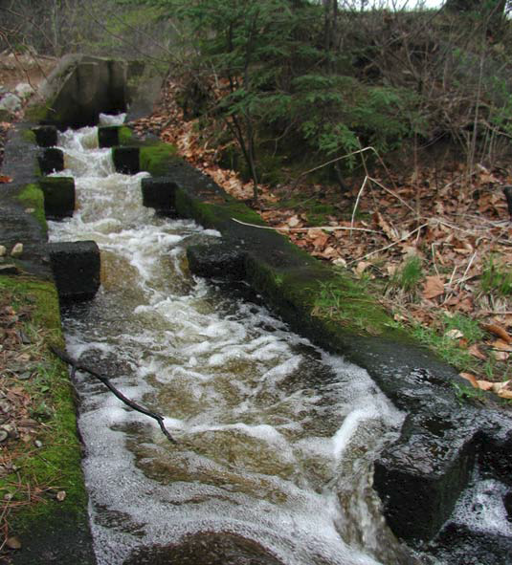
The Ipswich Mills and Willowdale dams have fishways,
South Middleton dam does not, but all fishways are not equal.
While they do provide a potential route to navigate dams, they are not easy for fish to use.
American Shad like me won’t even use these types of fish ladders.

Slide 16
Going upstream past dams and culverts is only part of the problem. Remember the Herring lifecycle?
Now add barriers into the mix...
Faced with a dam, some fish just turn around.
Once over a dam, fish are exhausted and likely to encounter MORE barriers.
Less fish making
their way to spawning
areas = less baby fish!
No thanks!
Which means less fish returning to these spawning grounds as adults.

Slide 17
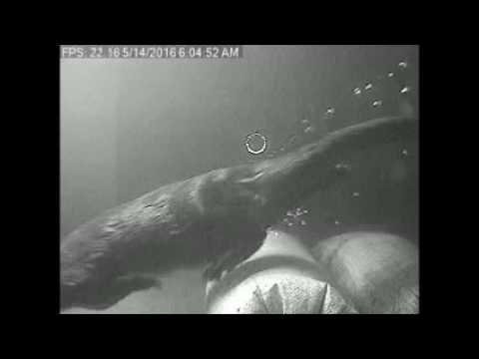
Going upstream past dams and culverts is only part of the problem. Remember the Herring lifecycle?
Now add barriers into the mix...
Faced with a dam, some fish just turn around.
Once over a dam, fish are exhausted and likely to encounter MORE barriers.
No thanks!

Slide 18
Going upstream past dams and culverts is only part of the problem. Remember the Herring lifecycle?
Now add barriers into the mix...
Faced with a dam, some fish just turn around.
Once over a dam, fish are exhausted and likely to encounter MORE barriers.
Less fish making
their way to spawning
areas = less baby fish!
No thanks!
Which means less fish returning to these spawning grounds as adults.

Slide 19
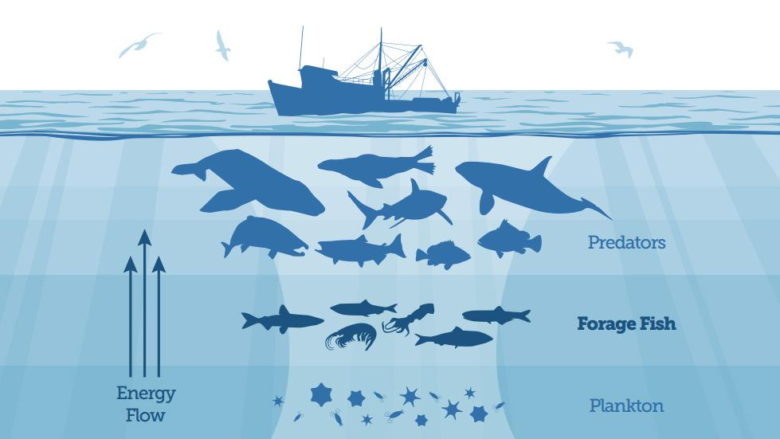
That’s bad for more than the Herring.
Herring are a keystone species due to their importance in the food web.
Many species eat herring, including sea birds, dolphins, orcas, seals, sharks, predator fish (like tuna) and humans. Marine predators alone can consume 300,000 tons of herring a year!
Like HERRING!

Slide 20
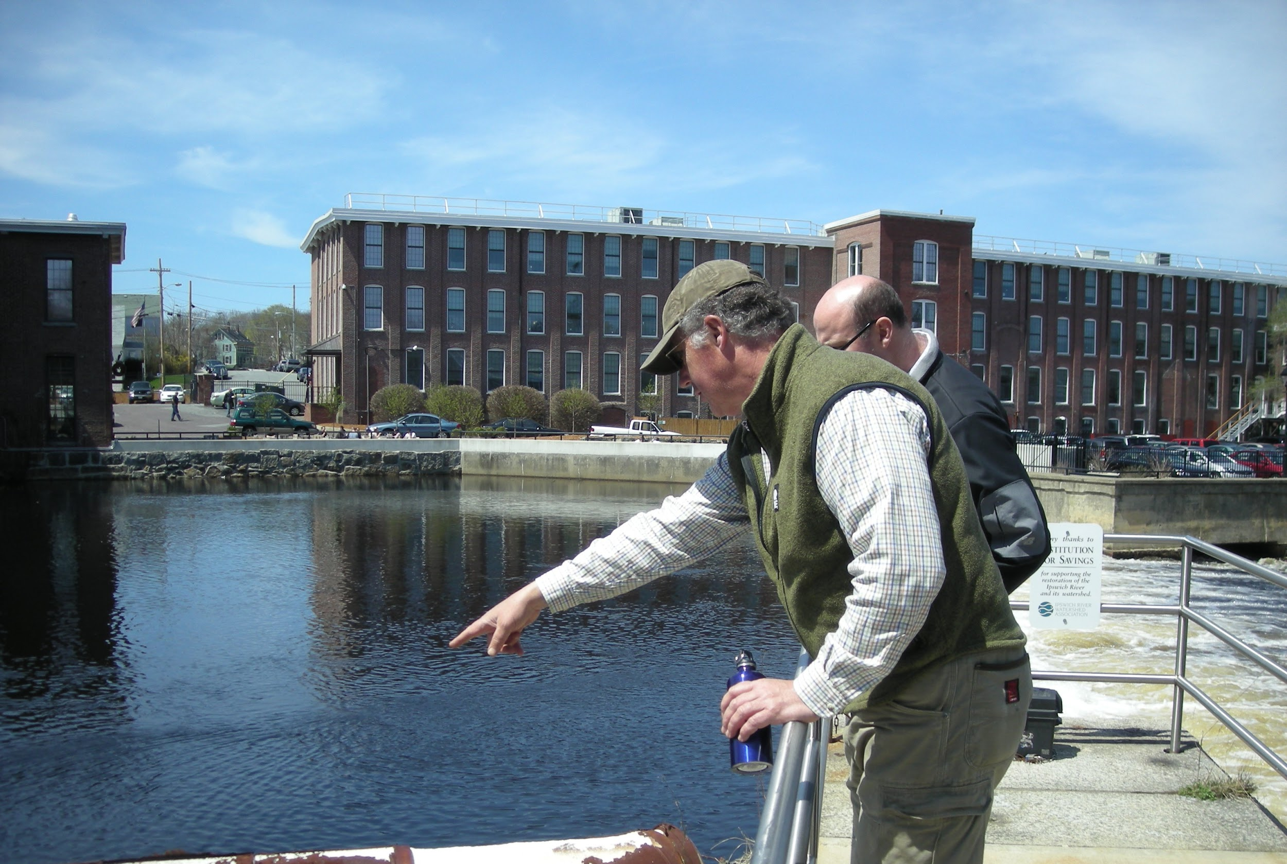
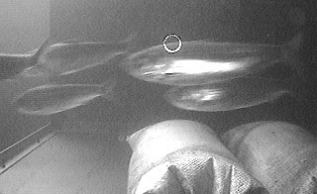
The Ipswich River once had annual runs of Herring numbering in the MILLIONS!
Since Herring are so important to maintaining the balance of life their migrations were once cause for celebration.
These days, their return is remarked by a few dedicated volunteers and the Ipswich Mills fish ladder.
Together the volunteer and fish cam counts let us calculate current Herring run sizes which have shrunk to around only 400.

Slide 21
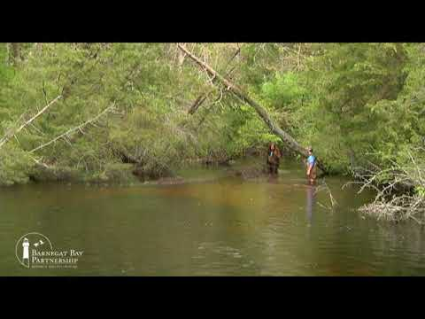
But there is hope.

Slide 22
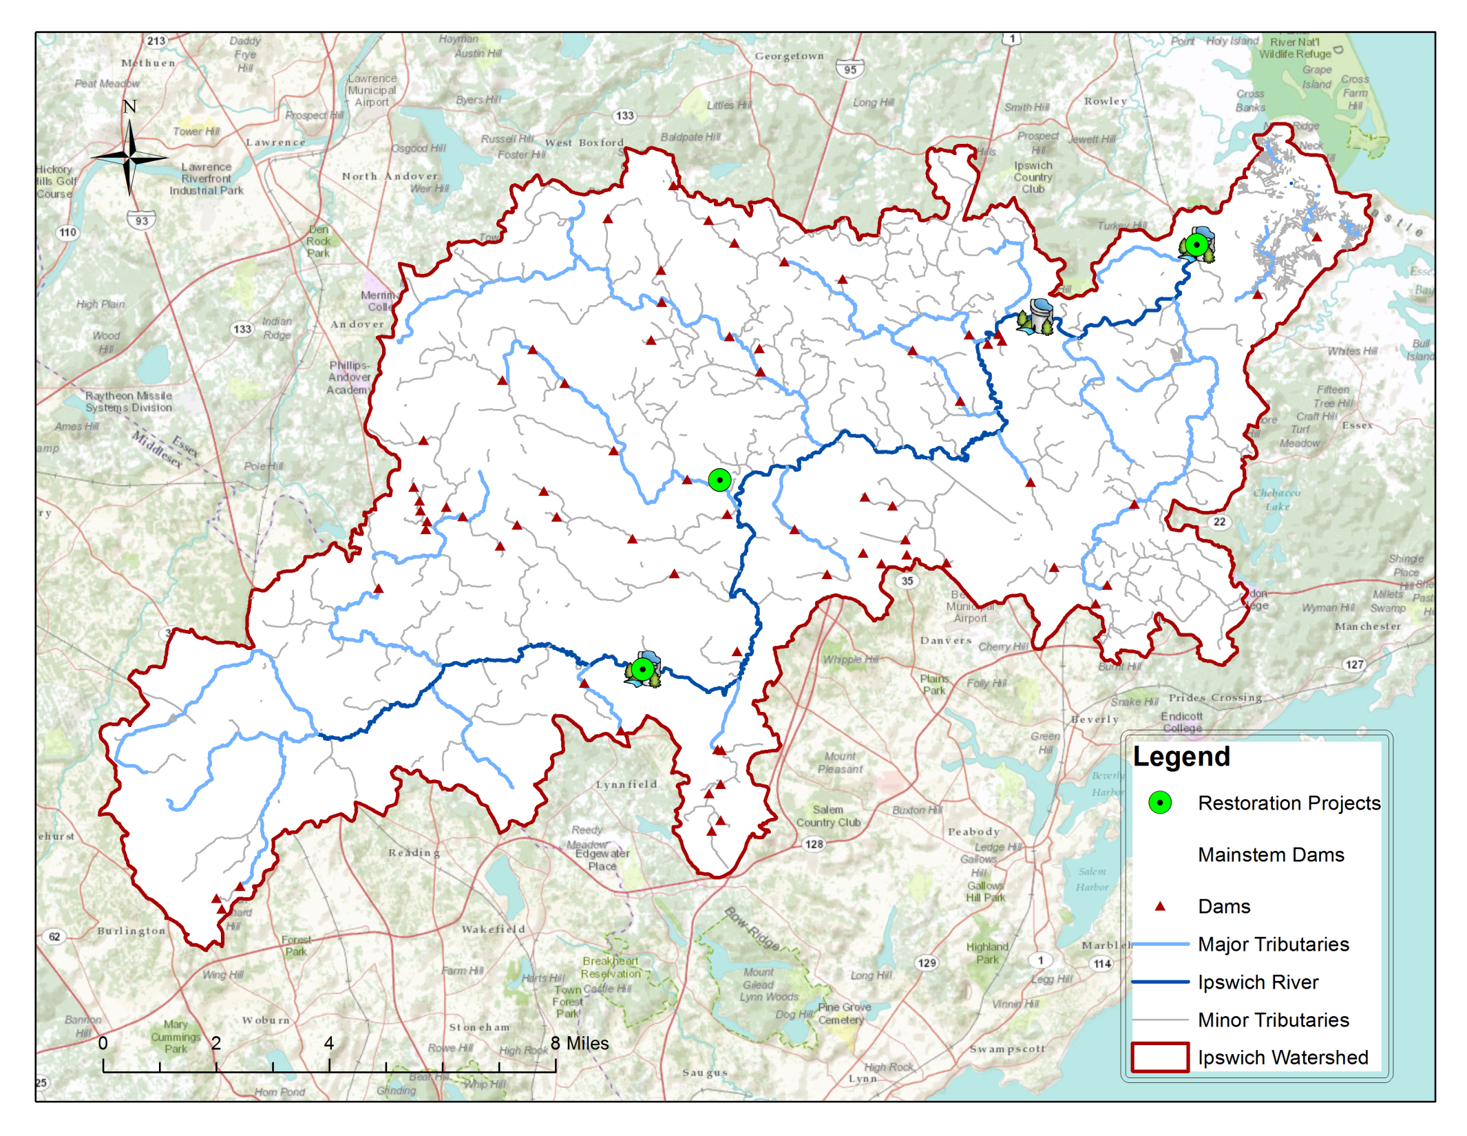
Willowdale Dam (Ipswich River) fish ladder upgrade
Active and potential
dam removal projects.
S. Middleton Dam (Ipswich River)
Ipswich Mills Dam (Ipswich River)
Projects are underway in the Ipswich River watershed to restore flow to the river and its tributaries and open up access to Herring habitat.

Slide 23

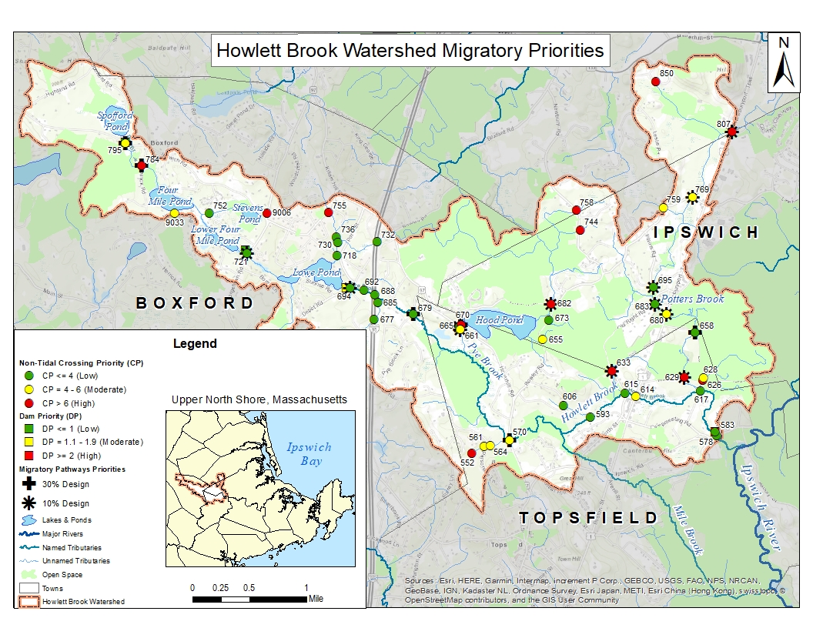
One project, funded by the National Fish and Wildlife Foundation,
aims to restore the Howlett Brook watershed as Herring Habitat.

Slide 24
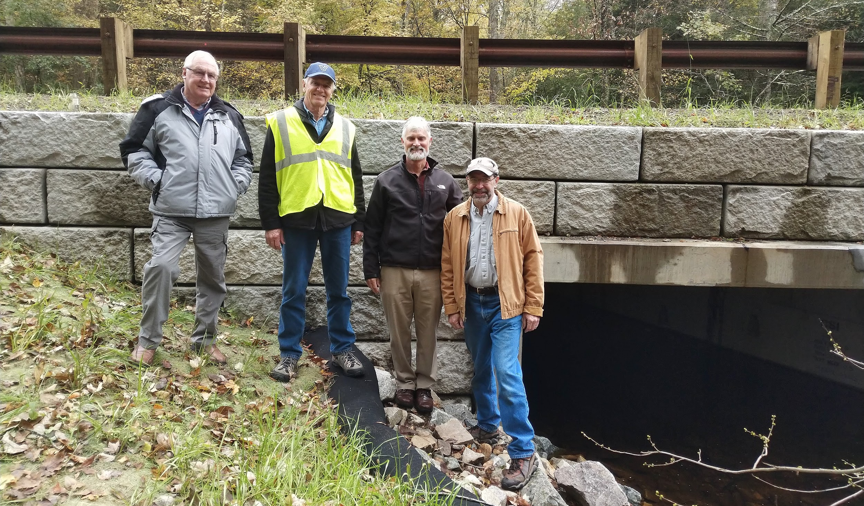
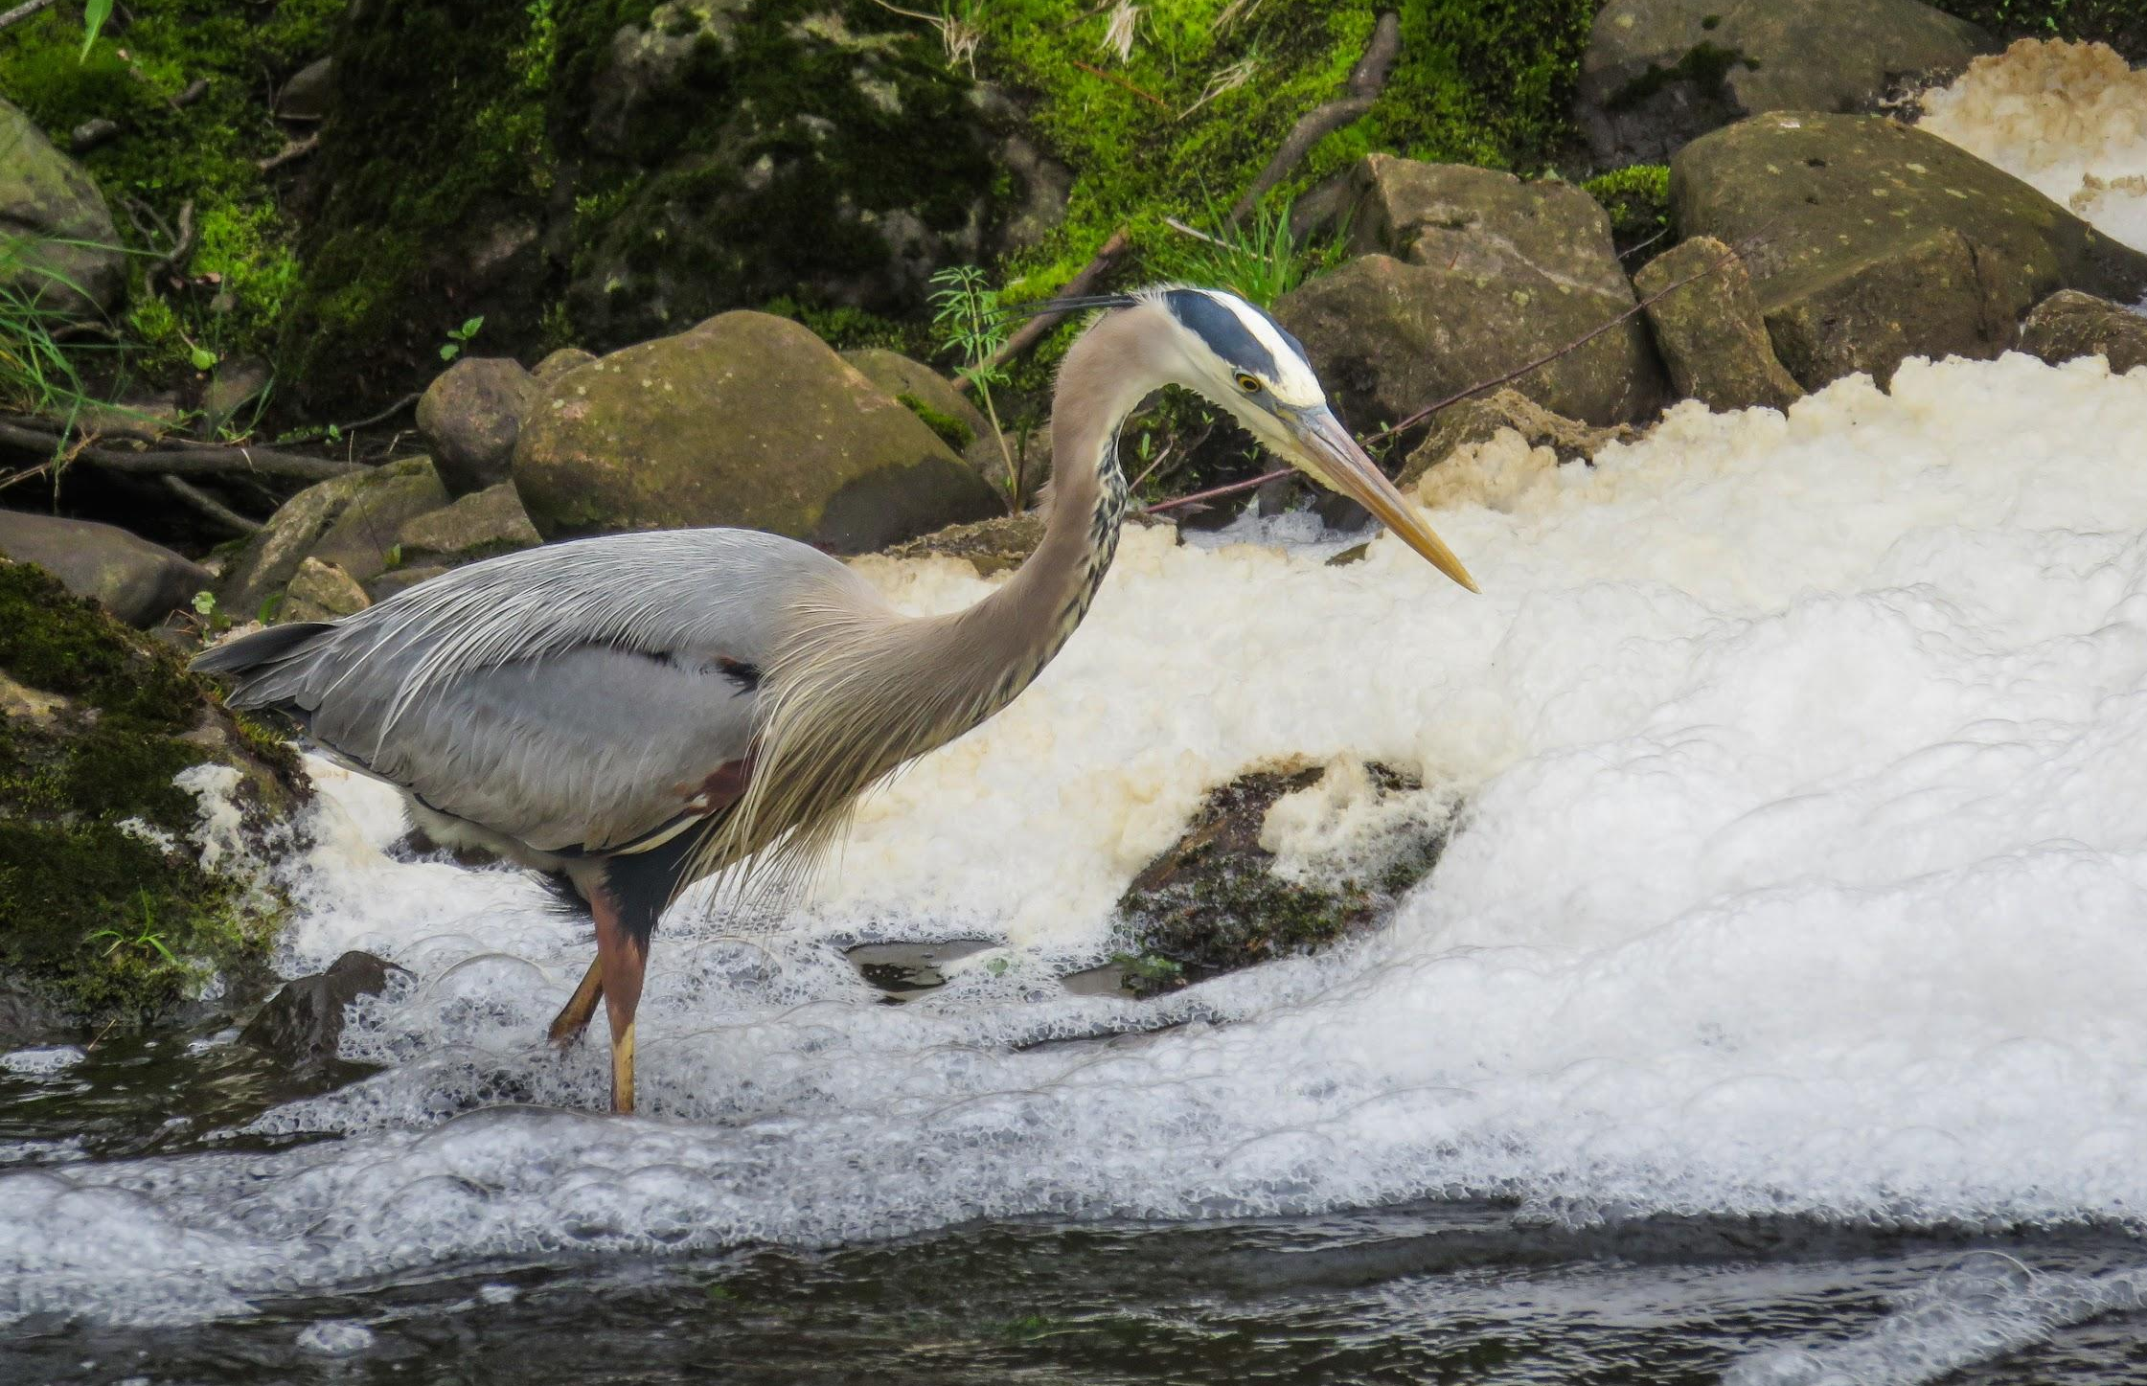
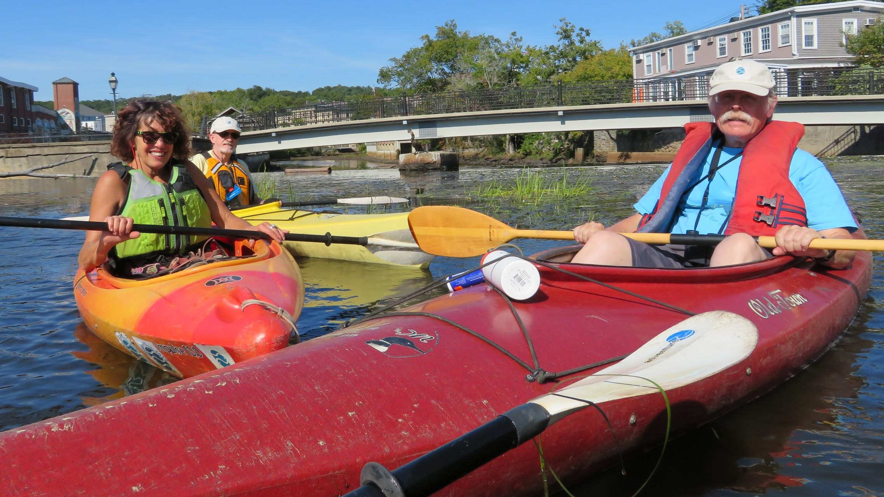
These restoration project will have other benefits, such as:
Increasing resiliency by repairing or replacing bridges and culverts that can cause flooding.
Opening waterways for recreational human access.
Creating and improving habitat for other species.
Boxford Town Staff and Trout Unlimited volunteers stand by upgraded culvert on Middleton Road in Boxford.

Slide 25
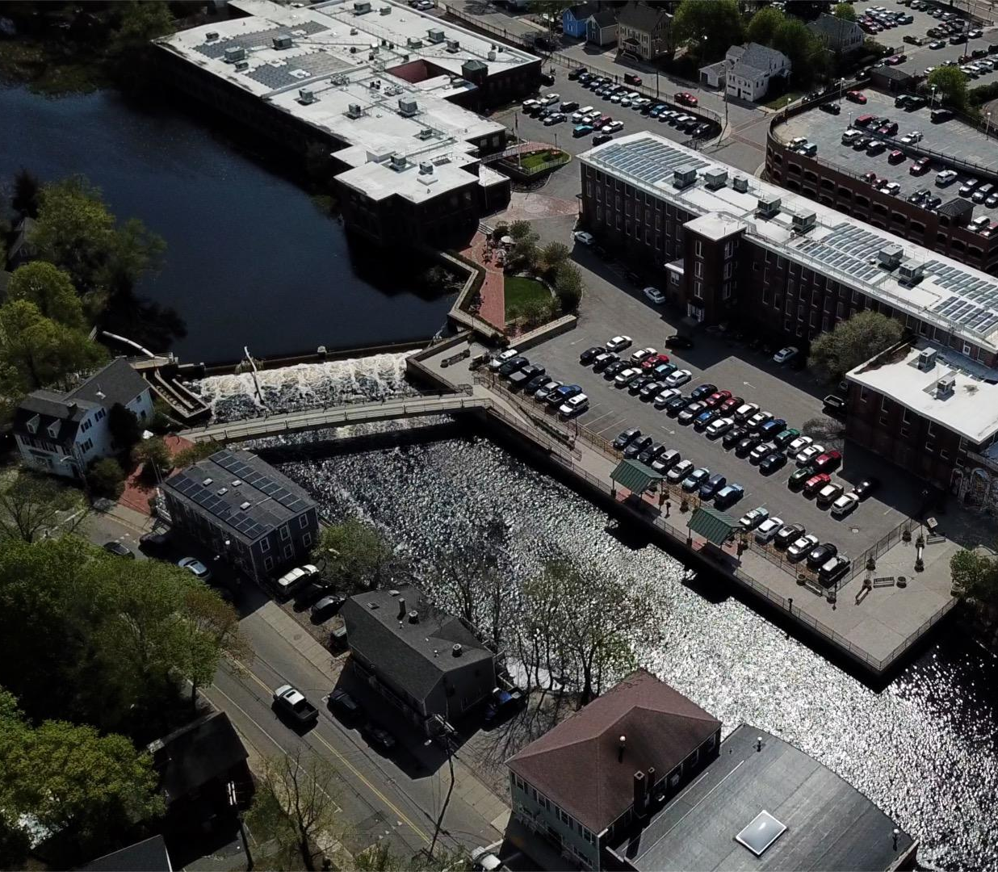
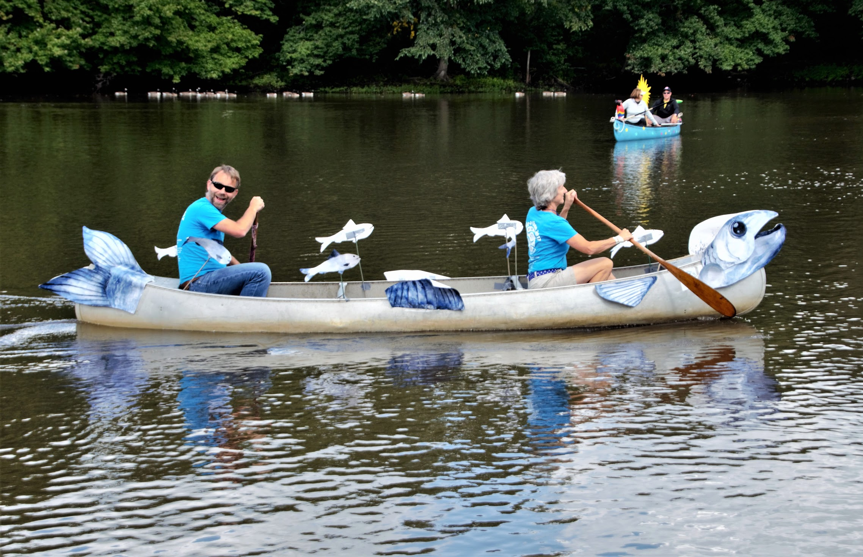
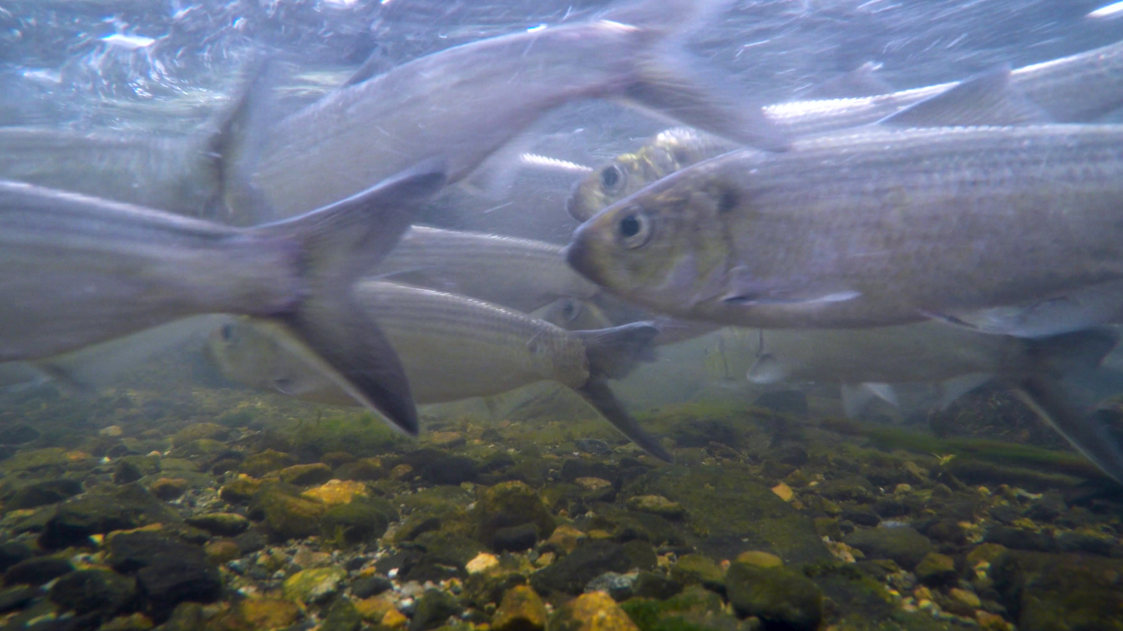

Herring, the Ipswich River, and its streams need our help.
When the flow between saltwater and freshwater, river and tributary, stream and pond were severed, we also lost some of our connection to the cycles and wonders of nature.
Let’s bring that connection, and the Herring back, and celebrate their return.

Slide 26
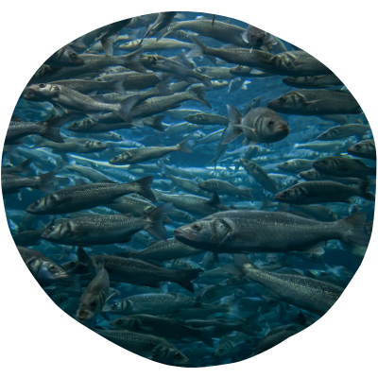
Thank you for attending
Remembering River Herring
Learn more about Ipswich River restoration projects at:
ipswichriver.org/restoration-resiliency
Learn more about the herring count at:
ipswichriver.org/herring-count
Keep up-to-date with Ipswich River events at:
ipswichriver.org/calendar
Follow us on Facebook
facebook.com/ipswichriver

